Slide 1

BERT-based language Model for Extracting Drug Adverse Events from Social Media
Fan Dong
02/27/2024
Disclaimer: The information in this presentation represents the opinions of the speaker and does not necessarily represent NCTR’s or FDA’s position or policy.
www.fda.gov/nctr

Slide 2
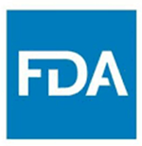
Highlights
Problems: During Covid-19 pandemic, social media platforms like Twitter, Facebook have emerged as valuable resources for real-time pharmacovigilance. However, extracting drug adverse events accurately and efficiently from social media poses challenges in both natural language processing research and the pharmacovigilance domain.
Questions: Could we utilize large language models to extract adverse drug event terms from social media data and thereby enhance drug safety surveillance?
Findings: Our study not only showcases the effectiveness of BERT-based language models in accurately identifying drug adverse events in social media data but also addresses the imperative for a comprehensive implementation study design and evaluation.
Meanings: Our study contributes to advancing pharmacovigilance practices and methodologies, particularly in the context of emerging information sources like social media.
www.fda.gov/nctr

Slide 3
Background
Coronavirus disease 2019(COVID-19) caused by the SARS-CoV-2 virus, is a highly contagious respiratory illness that emerged in late 2019 and led to a global pandemic.
The number of patients is huge.
A plethora of drugs are currently being utilized for COVID-19 patients.
Urgent need for Drug safety evaluation for COVID-19 Patients.
217 Drugs from 577 clinical trials registered on ClinicalTrials.gov for Covid-19 treatment
Citation:10.1038/s41598-021-93500-5
www.fda.gov/nctr

Slide 4
Background
Option 1: Drug Safety evaluation with FEARS:
Adverse Event Source : FDA Adverse Events Report Systems (FAERS)
Limitations:
Over 90% data are sponsor reported.
Population are not COVID-19 Patients specifically.
Option 2: Drug Safety evaluation with Social Media Data.
Features:
Real time monitoring
For COVID-19 patients
www.fda.gov/nctr

Slide 5
Background
Given the urgency of the Covid-19 pandemic, A remarkable number of drugs have been considered for treating Covid-19 but the efficacy of drugs remain unclear.
 | Social Media (Tweets) | FAERS
Timeliness | Real-time information as patients can post their experiences immediately | Result available after the completion of the trial
Volume and Scale | Huge volume generate from a diverse and global population | Limited to number of participants with limited demographic diversity
Data quality | Variable quality, as posts maybe subjective and can contain inaccuracies or exaggerations | High quality, as it is a regulated system with structure data collection
Data Structure | Unstructured | Structured
Use Cases | Useful for early signal detection, monitoring real-world use of medications | Essential for establishing the safety and efficacy of new medications in a controlled and rigorous manner
www.fda.gov/nctr
Notes:
Using both data sources in a complementary manner—leveraging the scale and timeliness of social media data alongside the rigor and control of clinical trial data—may offer a comprehensive approach to drug safety assessment.

Slide 6
Background
Drug safety assessment with Social media data poses a tough challenge.
Informal and unstructured nature of social media data
Huge data volume
Lack of standardization
Causal relationship between a drug and an adverse event
NLP challenges with informal language like for slang, abbreviations, and misspellings in social media posts
Traditional search and filtering techniques are insufficient for extracting and normalizing adverse events from social media data
www.fda.gov/nctr

Slide 7
Background
Large language models (LLM) advantage in processing social media.
LLMs are designed to understand human language in a context-aware manner
LLMs can process large volumes of text data quickly and efficiently
LLMs can be trained or fine-tuned to extract specific information from unstructured text
LLMs can help to standardize and normalize the diverse ways that people describe adverse events on social media
www.fda.gov/nctr

Slide 8

Objective
To use large language models (LLMs) to extract Adverse event from tweets during covid 19.
Input Tweets
Drug Adverse Events
Adverse Event Extraction Large Language Model
www.fda.gov/nctr

Slide 9
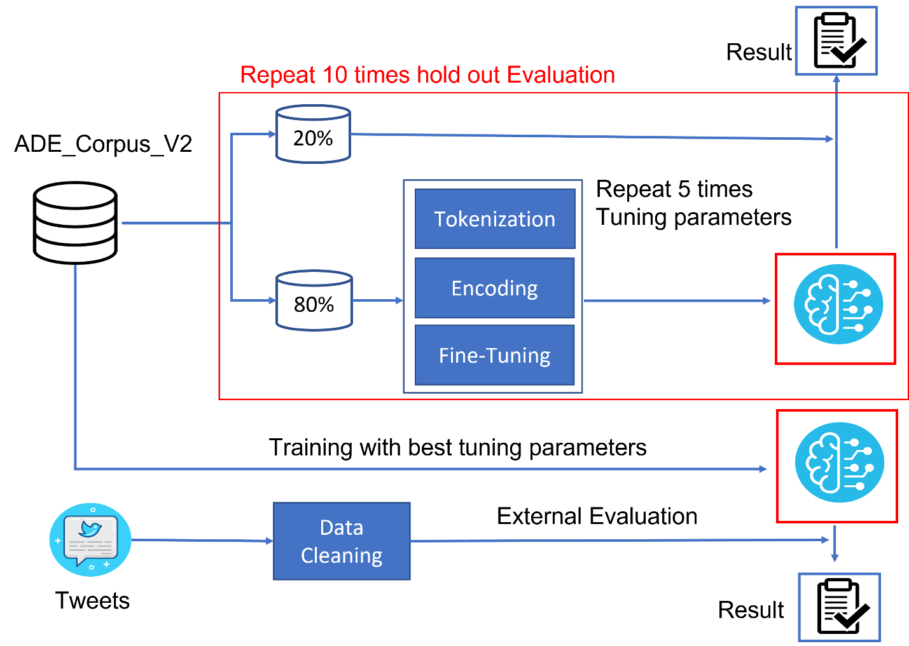
Study Design
www.fda.gov/nctr

Slide 10
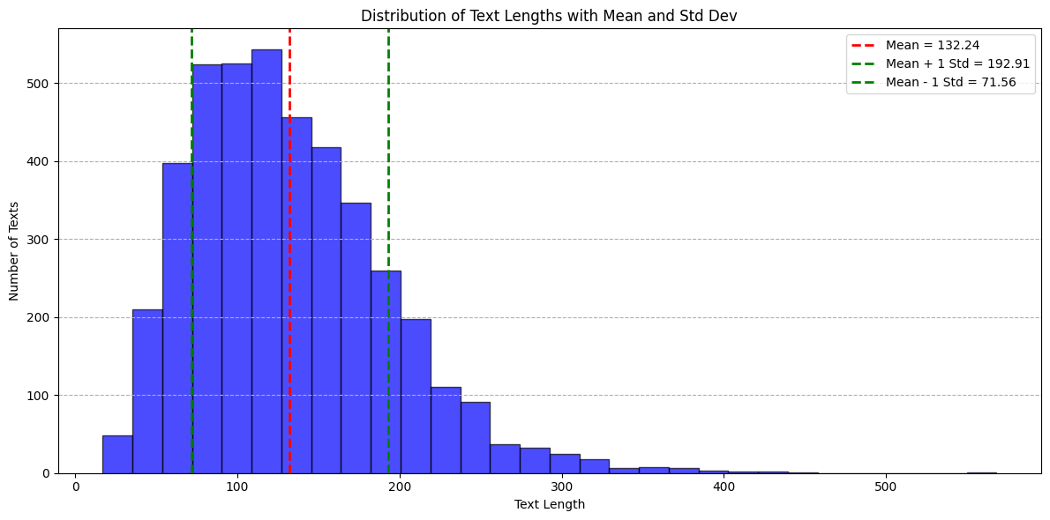
ADE-Corpus-V2 Dataset
The ADE-Corpus-V2 (Adverse Drug Event Corpus) is a dataset often used in biomedical natural language processing. It contains sentences extracted from the PubMed database, annotated for mentions of drugs and adverse effects.
This annotated dataset could help to support supervised learning task for extracting adverse events in document.
Number of documents | 4271
Number of Adverse Events | 6821
Distinct Adverse Events | 3341
3416 documents for training (80%)
855 Documents for testing (20%)
www.fda.gov/nctr

Slide 11
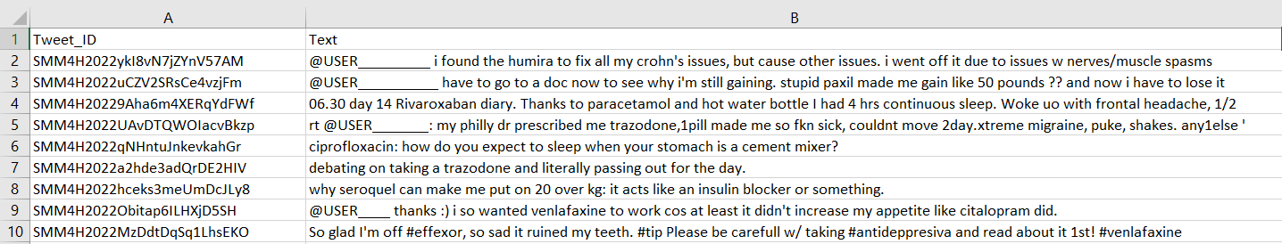
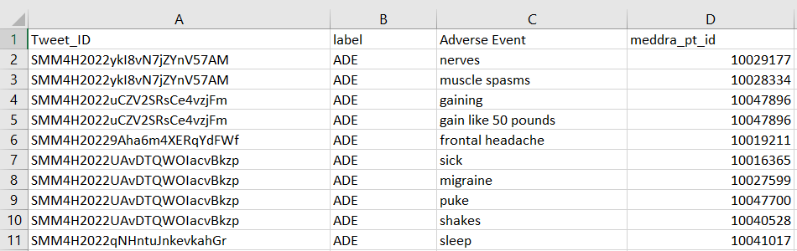
Tweet Dataset
Social Media Mining for Health (SMM4H) dataset.
909 Tweets.
87 Drug Adverse Events extracted.
61 distinct Drug Adverse Event Terms.
www.fda.gov/nctr

Slide 12

Adverse Event Extraction Model Details
Adverse Event Name Entity Recognition
Input
Output
ADE_Corpus_V2
Sentence 1
I | feel | like | a | zombie | after | taking | Advil
AE: feel like a zombie
Name Entity Recognition (NER) :
identifying and classifying named entities (Adverse Events) in text data.
Also be referred to as a special type of Token (word) Classification.
NER_class | Label | Meaning
O | 0 | Token is not part of named entity (Adverse Event)
B-AE | 1 | Beginning of named entity (Adverse Event)
I-AE | 2 | Inside named entity (Adverse Event)
I | feel | like | a | zombie | after | taking | Advil
O | B-AE | I-AE | I-AE | I-AE | O | O | O
www.fda.gov/nctr

Slide 13
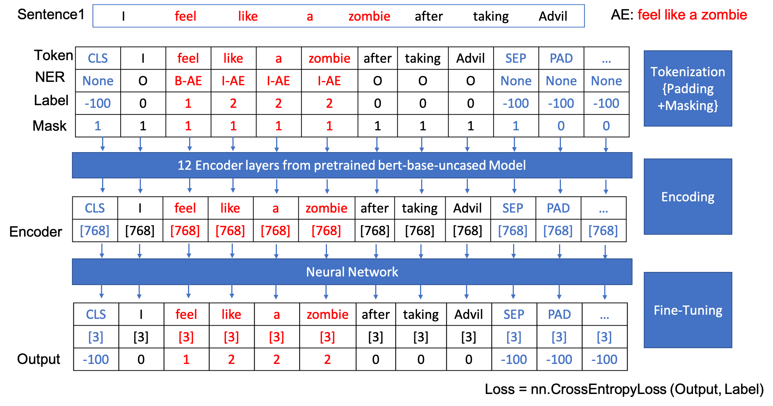
Adverse Event Extraction Model Details
www.fda.gov/nctr

Slide 14
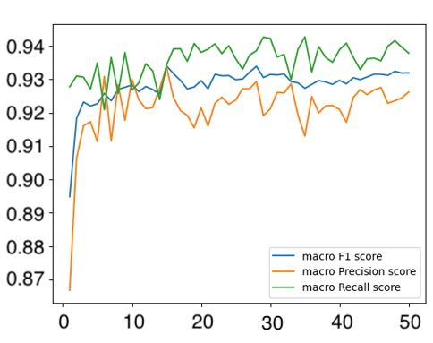
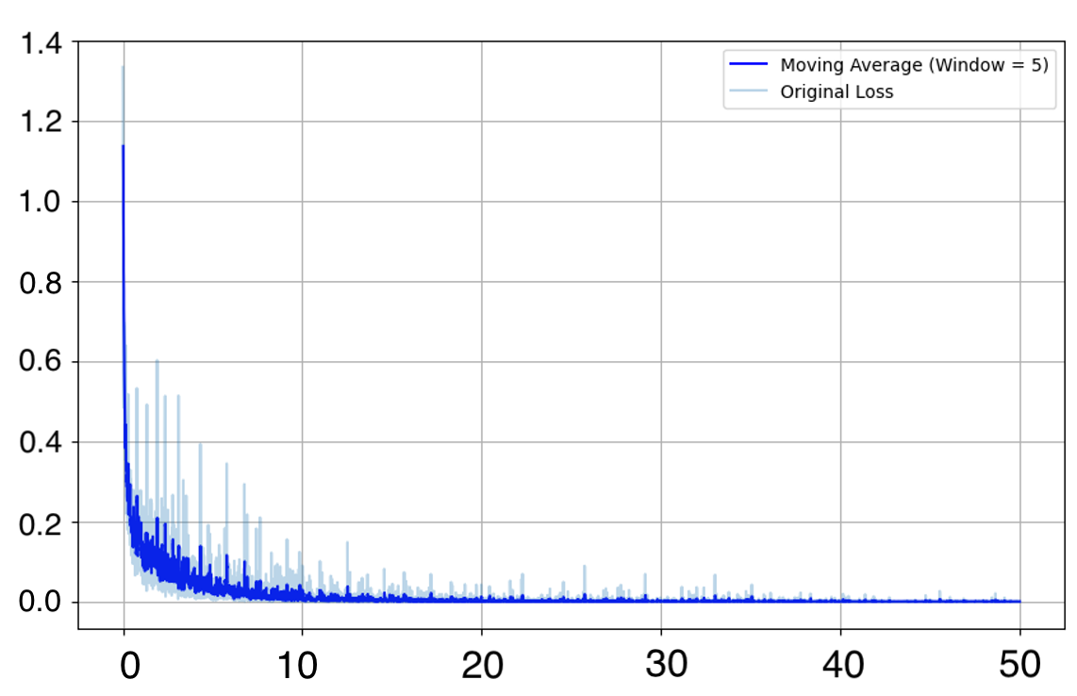
Adverse Event Extraction Model Fine-tuning
Epochs fine-tuning
www.fda.gov/nctr

Slide 15
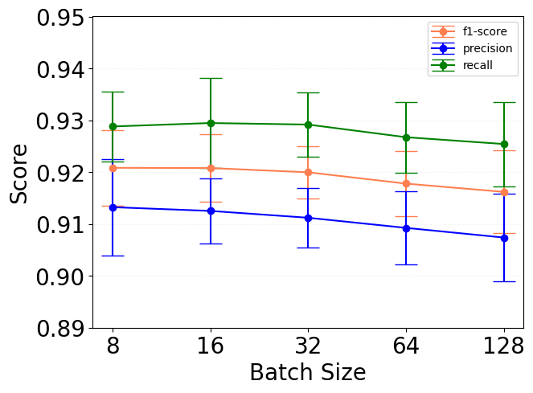
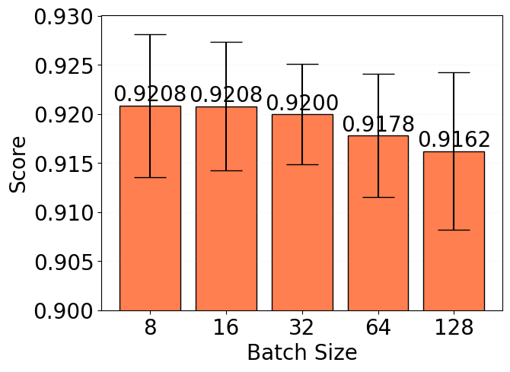
Adverse Event Extraction Model Fine-tuning
Batch size fine-tuning
www.fda.gov/nctr

Slide 16
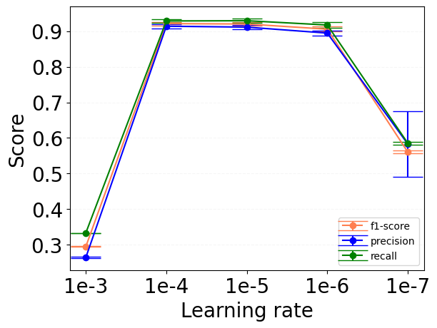
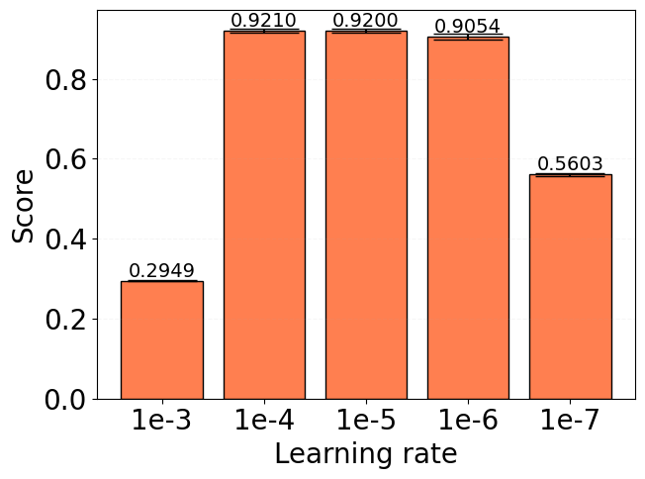
Adverse Event Extraction Model Fine-tuning
Learning rate fine-tuning
www.fda.gov/nctr

Slide 17
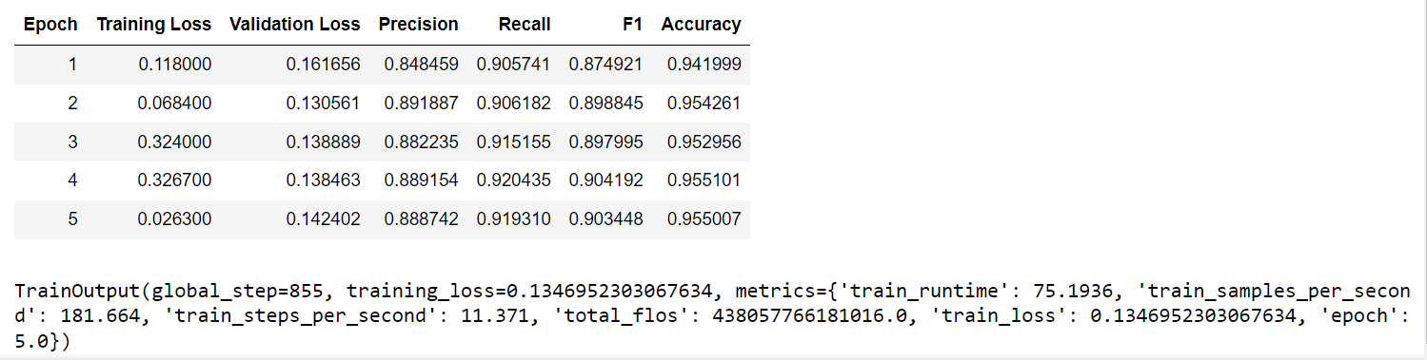
Adverse Event Extraction Model Training
model_checkpoint = "bert-base-uncased"
batch_size = 32
args = TrainingArguments(
f"{model_name}-finetuned-{task}",
evaluation_strategy = "epoch",
learning_rate=1e-5,
per_device_train_batch_size=batch_size,
per_device_eval_batch_size=batch_size,
num_train_epochs=50,
)
Training model with the best Fine-tuning parameters
www.fda.gov/nctr

Slide 18
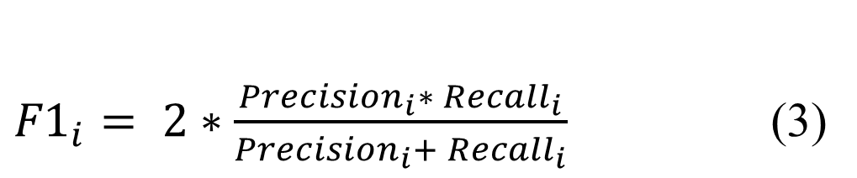
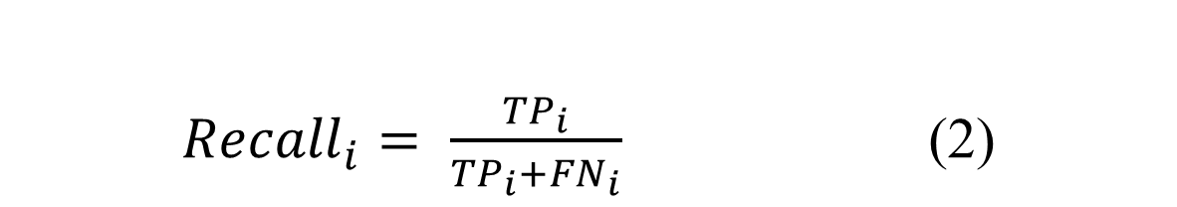
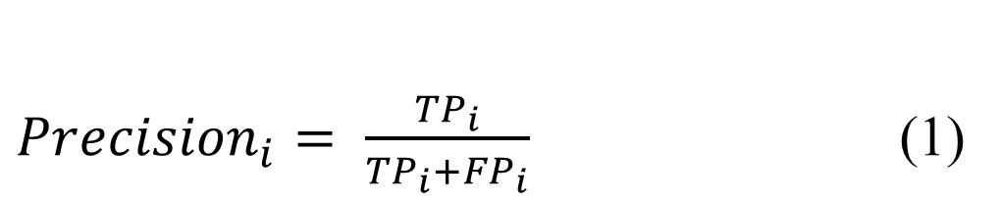

Evaluation Metrics
${Precision}_{i}= \frac{{TP}_{i}}{{TP}_{i}+{FP}_{i}}$ (1)
${Recall}_{i}= \frac{{TP}_{i}}{{TP}_{i}+{FN}_{i}}$ (2)
${F1}_{i}= 2∗\frac{{Precision}_{i}∗ {Recall}_{i}}{{Precision}_{i}+ {Recall}_{i}}$ (3)
$TP$: True Positive
$FP$: False Positive
$FN$: False Negative
www.fda.gov/nctr

Slide 19
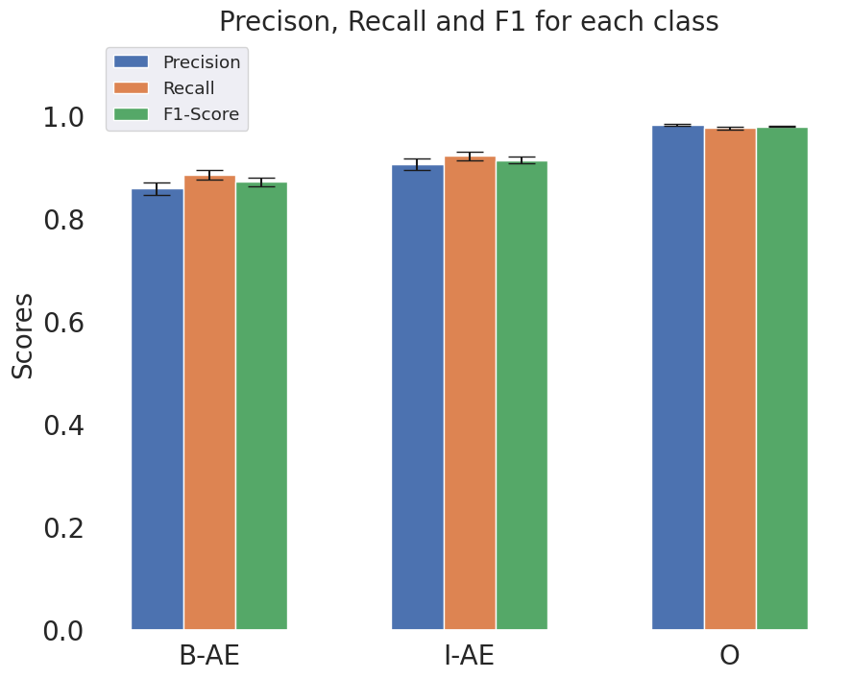
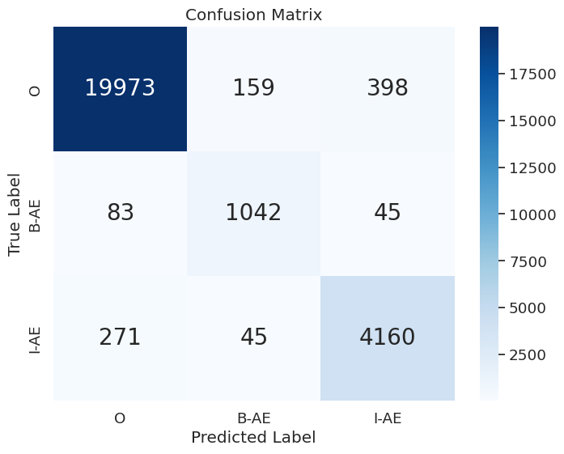
10 times hold out Internal Evaluation on ADE-Corpus-V2
www.fda.gov/nctr

Slide 20
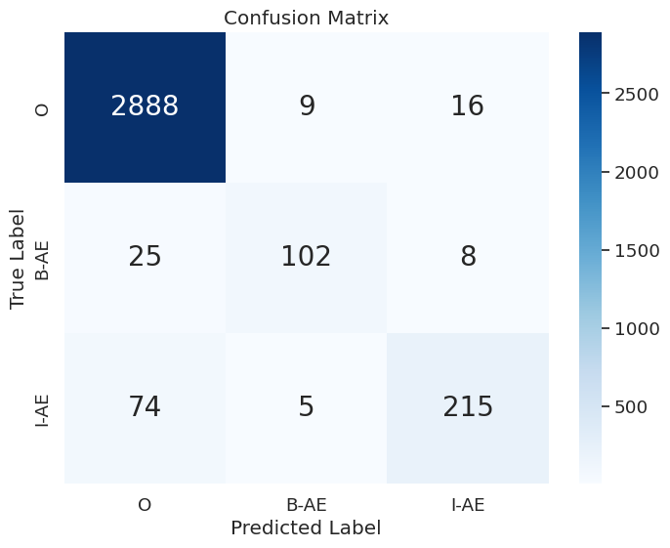
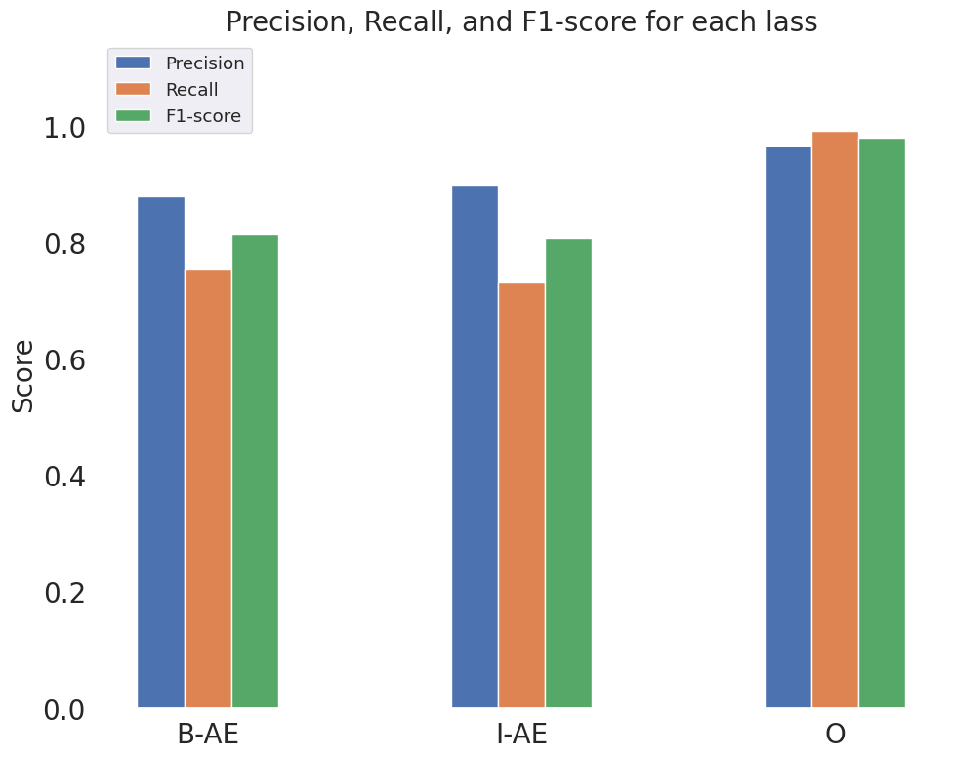
External Evaluation Result on SMM4H
www.fda.gov/nctr

Slide 21
Case study for External Evaluation on SMM4H
Case | AE terms extraction example in Tweets Data
exactly recognized AE | 06.30 day 14 Rivaroxaban diary. Thanks to paracetamol and hot water bottle I had 4 hrs continuous sleep. Woke uo with frontal headache, 1 2
miss recognized AE | rt my philly dr prescribed me trazodone,1pill made me so fkn sick, couldnt move 2day.xtreme migraine, puke, shakes. any1else
partially recognized AE | well i'm taking it with a mood stabilizer (lamictal). i can't take anti-depressants by themselves-triggers my rapid cycling
recognized more than AE | does cipro make anyone's else's brain turn to mush or am i actually just going crazy?
www.fda.gov/nctr

Slide 22
Summary
Our research underscores the significance of social media platforms as valuable resources for monitoring health-related information and adverse events associated with medications and treatments in drug safety surveillance.
Our study not only highlights the efficacy of BERT-based language models in identifying drug adverse events in the dynamic landscape of social media data but also emphasizes the importance of a comprehensive implementation study design and evaluation.
Leveraging publicly available labeled adverse event data from the ADE-Corpus-V2, we optimized key hyperparameters during model construction. Through ten hold-out evaluations on ADE-Corpus-V2 data and external validation using human-labeled adverse event tweets data from SMM4H, our model consistently demonstrated high accuracy in drug adverse event detection.
Our research contributes to advancing pharmacovigilance practices and methodologies, particularly in the context of emerging information sources like social media.
www.fda.gov/nctr

Slide 23
Acknowledgement
Group members and advisor
Dr. Wenjing Guo
Dr. Jie Liu
Dr. Zoe Li
Dr. Aasma Aslam
Dr. Huixiao Hong
www.fda.gov/nctr

